Slide 1
Where Environment Meets Disease: “A Bivariate Analysis of Malaria in Nigeria”
Tiwa Daodu

Slide 2
Introduction
Why temperature?
Malaria transmission increases within an optimal temperature range (about 20–30°C), where both mosquito activity and parasite development are most efficient.
The pattern between the environmental factor (temperature) and malaria would be displayed via a bivariate map.
A bivariate map visualizes two variables at once to highlight spatial relationships and interactions between them.
Working Assumption:
Areas with higher temperatures are expected to show higher malaria prevalence due to more favorable conditions for mosquito breeding and parasite development.
Temperature
Transmission
Malaria Prevalence
Disease burden

Slide 3
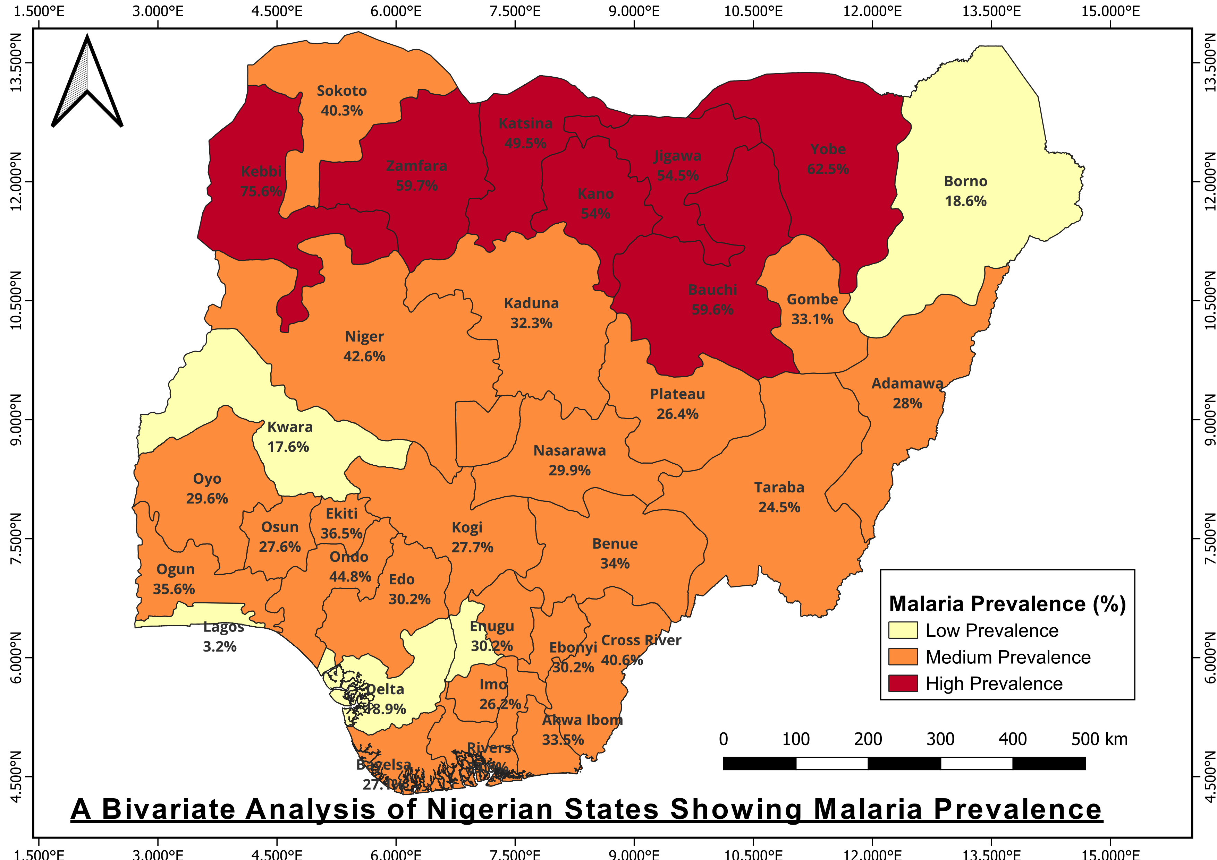
The northern states exhibited the highest malaria prevalence levels, indicating significant malaria burden compared to the south states.
Kebbi and Yobe had the highest levels
In contrast, states like Lagos and Kwara showed relatively low prevalence, suggesting lower transmission levels in these regions.
These variations may be influenced by factors such as environmental conditions, population distribution, and access to healthcare services.

Slide 4
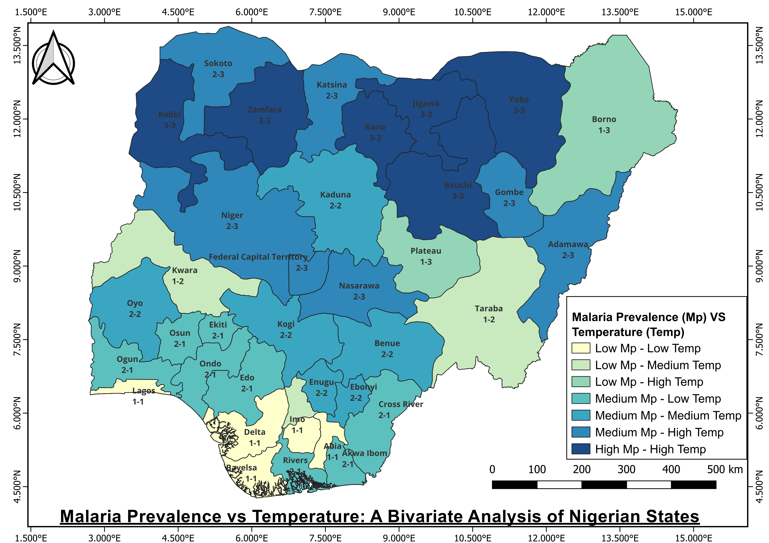
The dominance of “high–high” combinations in the north suggests a positive spatial association between temperature and malaria prevalence.
An outlier, Borno, showed relatively low malaria prevalence despite experiencing high temperatures similar to other northern states with high malaria rates.
Several factors could explain this;
An arid climate may limit mosquito breeding habitats.
Ongoing security challenges may affect population movement and healthcare access

Slide 5
Conclusion
Other factors such as availability of healthcare facilities, healthcare access, population density, water management, poverty also play a role in malaria prevalence.
Thank you

